Slide 1
.NET Core Workshop
Mariano Sánchez
sanchezmariano@outlook.com @marianosz
http://weblogs.asp.net/marianos

Slide 2
.NET: the family gets bigger
.NET FRAMEWORK
.NET CORE
XAMARIN
Platform for .NET applications on Windows
Cross-platform and open source framework optimized for modern app needs and developer workflows
Cross-platform and open source Mono-based runtime for iOS, OS X, and Android devices
Distributed with Windows
Distributed with app
Distributed with app
Notes:
Notes: Focus on the great additions to the .NET Framework, enabling developers to target the latest applications in the cloud and devices. Explain the distribution mechanism of each. .NET Framework is distributed and available on Windows whereas .NET Core & Xamarin are distributed with the app.

Slide 3
.NET Runtimes
Full .NET CLR
Includes all APIS, and ensures backward compatibility.
.NET Core
Small (11 MB)
Composable, distributed via NuGET
Side by Side
Cross-Platform
Windows, OS X, Linux
Ryujit y .NET GC OSS

Slide 4
Languages
C#
Flexible, powerful, multi-purpose
Investments in C# 7: Evolve for modern patterns in distributed applications: tuples, pattern matching, others.
VB
Simple, easy to use
Investments in VB 15: Bring key language features and platforms while keeping VB simplicity principles.
F#
Elegant functional programming
Investments in .NET Core: Language updates for C# 7 / VB 15 interop, platform support and tooling updates.
Notes:
C#, Visual Basic and F# are all supported on .NET Core and can be used to create cross-platform apps that run anywhere. In addition, C# is supported in other cross-platform editors like Visual Studio Code via OmniSharp. Currently there are project templates provided C# in Visual Studio and Visual Basic templates will be added as the tooling reaches RTM (with Visual Studio NEXT).

Slide 5
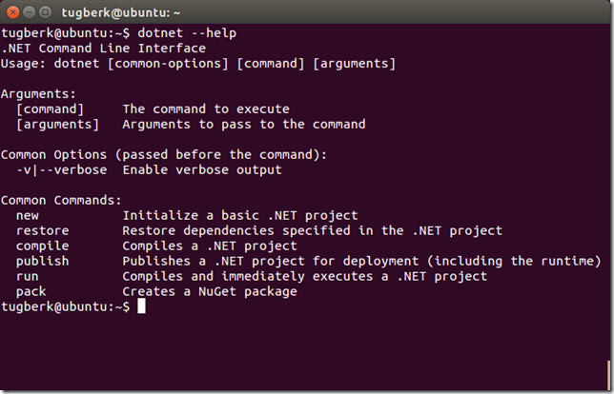
.NET Command Line Interface (CLI)
A single tool for compiling, deploying, and managing .NET applications on all platforms
Notes:
The .NET Execution Environment (DNX) is a software development kit (SDK) and runtime environment that has everything you need to build and run .NET applications for Windows, Mac and Linux. It provides a host process, CLR hosting logic and managed entry point discovery. DNX was built for running cross-platform ASP.NET Web applications, but it can run other types of .NET applications, too, such as cross-platform console apps

Slide 6



Development Tools
Visual Studio 2017
Visual Studio
Visual Studio Code
Visual Studio Code
Other editors: Sublime Text, Atom, etc.
Other editors: Vi, Emacs, Atom, etc.
Visual Studio Code

Slide 7
ASP.NET Core

Slide 8


ASP.NET Core and the modern web
Totally modular
Faster development cycle
Seamless transition from on-premises to cloud
Choose your editors and tool
Open source with contributions
OSS
Cross-platform
Fast

Slide 9
Kestrel in a ASP.NET Core App
Hello world!!
Request
Kestrel
Response

Slide 10
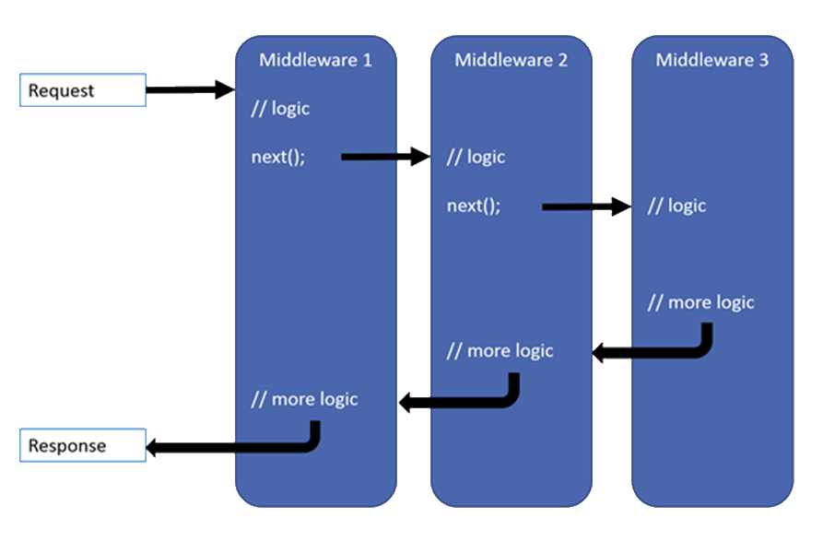
Middleware

Slide 11
Kestrel + Middlewares
Request
Middleware
next()
Middleware
Middleware
next()
Kestrel
return
return
Response
return

Slide 12
ASP.NET Core MVC

Slide 13
Models, Views, and Controllers
What does MVC look like?
Request
Controller

Model

Response
View

Notes:
20486A
01: Exploring ASP.NET MVC 4

Slide 14
Web APIs
Web API
MVC App
HTML5 App
Mobile App

Slide 15


Data Access
.NET Core offers providers for Data Access on different platforms:
SQL Server / Azure SQL Database
PostgreSQL
SQLite
MySQL
No changes to the data access code
ADO.NET
Entity Framework
No data migration needed
Azure SQL Database
SQL Server
In cloud
On premise

Slide 16
Deploy
Xcopy deployment
On-premises
Azure - Windows or Linux VMs
Docker container
Windows container
You can use any of the deployment technology available on the corresponding OS (Windows / Linux / OS X)
.NET Core travels with the app
A machine-level .NET installation is not required, only the runtime.

Slide 17
Going to Production
Run it with a
reverse proxy
:80/:443
:5000
IIS – nginx – apache
IIS
Kestrel
Install ASP.NET Core Module first
My Web App
nginx
Apache

Slide 18
.NET yesterday—app models and libraries
.NET FRAMEWORK
.NET CORE
XAMARIN
APP
MODELS
WPF
Windows Forms
UWP
iOS
Android
ASP.NET
ASP.NET Core
OS X
BASE
LIBRARIES
Base Class Library
Core Library
Mono Class Library
COMMON INFRASTRUCTURE
Compilers
Languages
Runtime components
Notes:
Notes: Even if we are reusing a lot across components (especially with the open sourcing last year), the reality is that each platform has its own implementation of the base libraries.
Note: .NET Framework BCL and Mono BCL are the same APIs, different implementation. .NET Core “Core Library” is a similar set of APIs, but different.

Slide 19
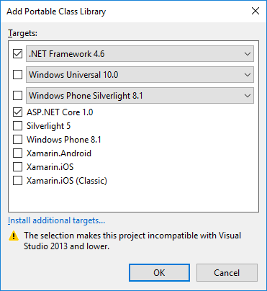

Code Sharing – Portable Class Library
.NET Framework
Windows Universal
Windows Phone

Slide 20
.NET today
.NET FRAMEWORK
.NET CORE
XAMARIN
WPF
Windows Forms
UWP
iOS
Android
ASP.NET
ASP.NET Core
OS X
.NET STANDARD LIBRARY
One library to rule them all
COMMON INFRASTRUCTURE
Compilers
Languages
Runtime components
Notes:
Notes: Please welcome the .NET Standard Library [explain details]
As we move into the future we want to make it much easier for .NET developers to write their code once and be able to execute across .NET implementations, whether that’s .NET Framework, .NET Core, or Mono/Xamarin. To this end, we will continue to evolve and expand the .NET Standard into a set of APIs that are shared broadly across frameworks and application models. This will provide our ecosystem with much more explosive growth with libraries that can shared much more easily.

Slide 21
.NET Standard
.NET Standard is a specification that represents a set of APIs that all .NET platforms have to implement.
This unifies the .NET platforms and prevents future fragmentation.

Slide 22
APIs in .NET Standard 2.0
XML
XLinq • XML Document • XPath • Schema • XSL
SERIALIZATION
BinaryFormatter • Data Contract • XML
NETWORKING
Sockets • HTTP • Mail • WebSockets
IO
Files • Compression • MMF
THREADING
Threads • Thread Pool • Tasks
CORE
Primitives • Collections • Reflection • Interop • Linq

Slide 23
.NET Growth in Visual Studio
+1 million new monthly active .NET developers in last year!

Slide 24
Open source momentum
Community PRs by month
19,000+ Community Contributions from 3700+ Companies outside Microsoft

Slide 25
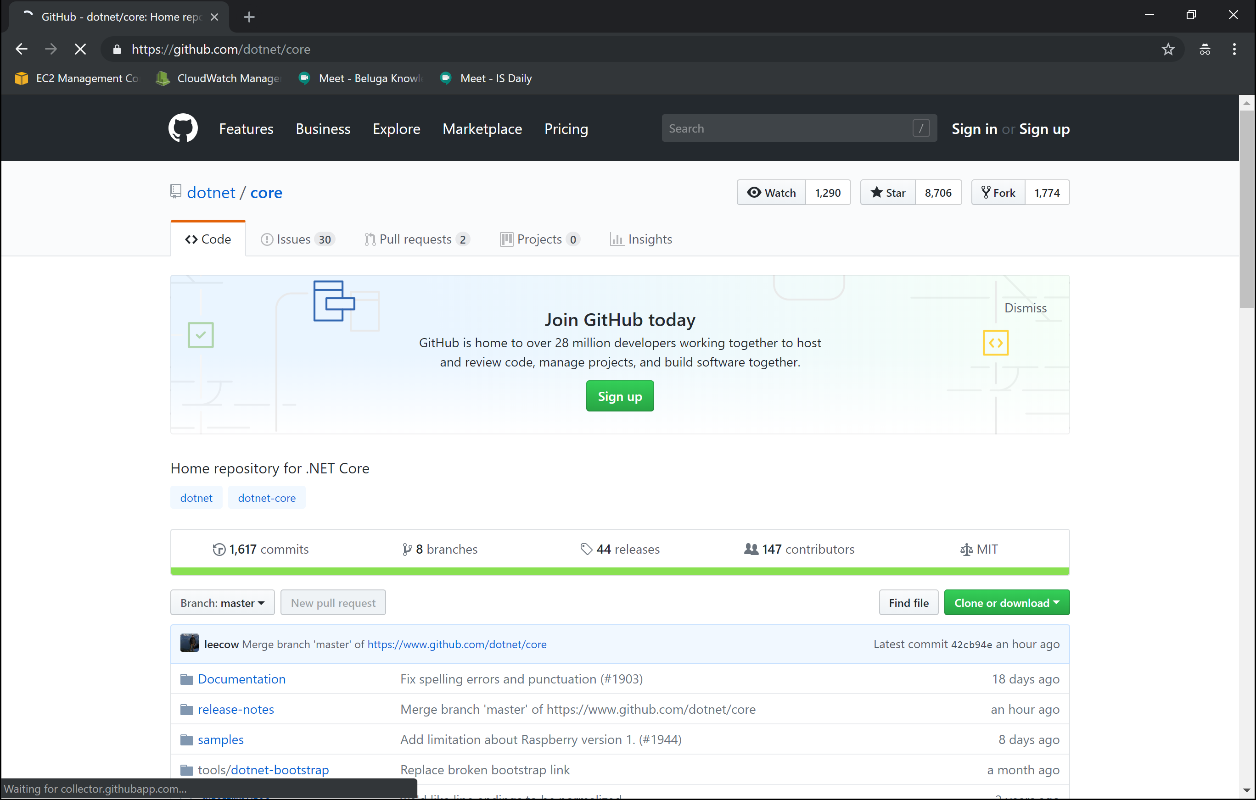
https://github.com/dotnet/core

Slide 26
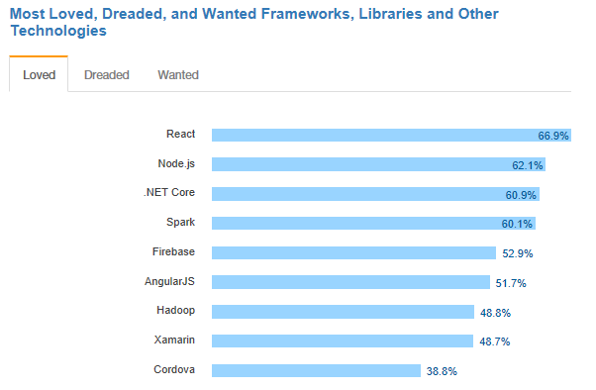
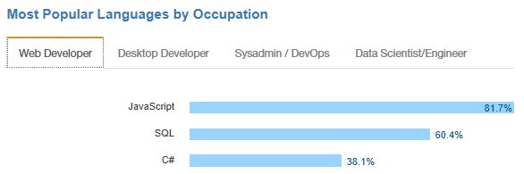
.NET is active and growing
.NET Core debuts at #3 most loved Framework on Stack Overflow Technology Survey 2017
C# is #3 most popular language for desktop and web developers on Stack Overflow Technology Survey 2017
Source: http://stackoverflow.com/insights/survey/2017

Slide 27

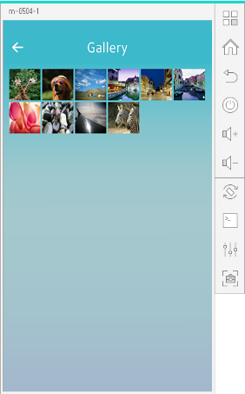
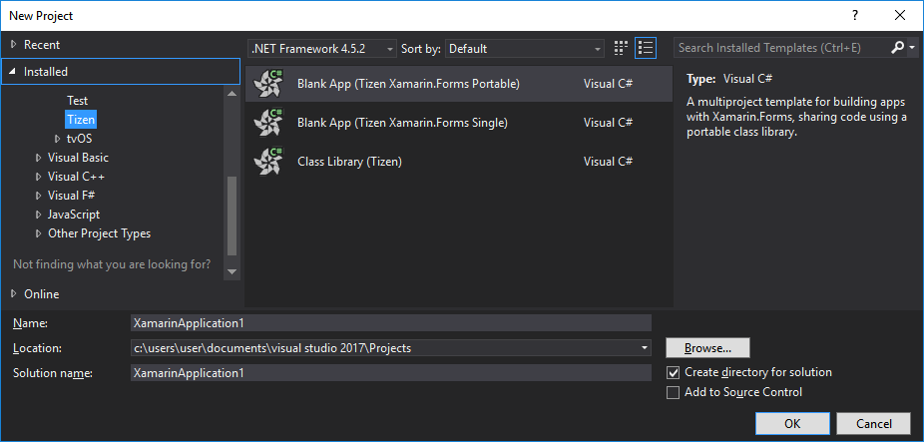
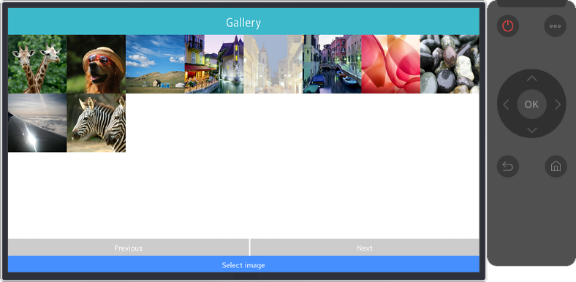
.NET Core Support on Tizen
Build Tizen apps for mobile devices and TVs with .NET Core and Xamarin.Forms
Preview #1
Preview #2
Preview #3
Preview #4
Official Release
Mobile
Nov 2016
Mobile/TV
Jan 2017
Mobile/TV
Mar 2017
Mobile/TV
June 2017
Mobile/TV
End of 2017
Visual Studio Tools for Tizen
Supports everything you need to
develop Tizen apps with .NET
https://developer.tizen.org/development/tizen-.net-preview/

Slide 28
Guidance - .NET Architecture
Available now at: https://dot.net/architecture
eBooks & samples: Web, Containers, mobile
Patterns: Health checks, queueing
More books and patterns coming…

Slide 29
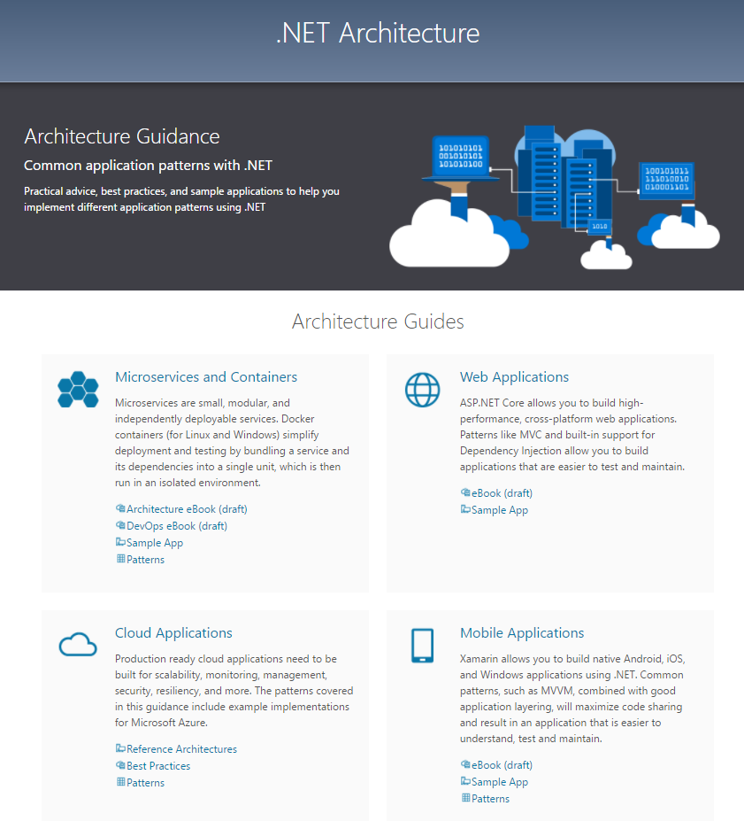

Slide 30
Announcing .NET Core 2.1 https://aka.ms/DotNetCore21

Slide 31
.NET Core 2.1 Themes
Faster Build & Runtime Performance
Close gaps in ASP.NET Core and EF Core
Improve compatibility with .NET Framework
GDPR and Security
Microservices and Azure
Faster Internal Engineering System

Slide 32
.NET Core 2.1 Tooling Performance
TIME IN SECONDS

Slide 33
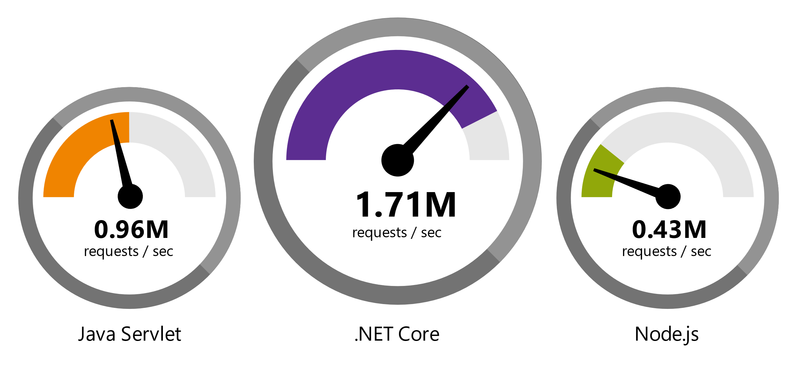
.NET Core 2 is Fast
Data sourced from official tests available at TechEmpower Round 14.
“Using the same-size server, we were able to go from 1,000 requests per second per node with Node.js to 20,000 requests per second with .NET Core.“ — Raygun
https://www.microsoft.com/net/customers

Slide 34
.NET Core 2.1 is Faster!
REQUESTS / SECOND
+12%
+11%
+123%

Slide 35
.NET Core 2.1 Major Features
.NET Core
Lazy Loading
Value conversions
Query types
Data seeding
ASP.NET Core
Global Tools
Span<T>
Sockets
HttpClient Performance
Windows Compatibility Pack
EF Core
HTTPS
Razor UI as a library
HttpClientFactory
ASP.NET Core SignalR

Slide 36
Tooling - Visual Studio 2017
Improved performance, new install experience
Faster navigation
Code style configuration and enforcement
Live Unit Testing
IntelliSense improvements
New exception helper
More refactorings and quick fixes
C# 7.0

Slide 37
Visual Studio 2017 Update 3
Additional polish to navigation and IntelliSense
.NET Core support for Live Unit Testing
Code style enforcement on builds
More live diagnostics on API design, security, etc.
Even more refactorings and quick fixes
C# 7.1

Slide 38
Tooling - Visual Studio for Mac
Provide the SAME experience across Windows and Mac
Sharing components with Visual Studio
.NET Core Project Templates
HTML, CSS, JSON editors
Backend debugger
Azure Publish infrastructure
Future
Javascript, Razor editors

Slide 39
.NET Core and Visual Studio for Mac
Full .NET Core Tooling including round tripping between Windows and Mac
Docker Containers with debugging
Publish to App Service
Publish to App Service Containers
Azure Functions

Slide 40
Resources
.NET Core SDK
https://www.microsoft.com/net/core/
VS 2017 Update 3
https://www.visualstudio.com/vs/
.NET Architecture
https://www.microsoft.com/net/architecture
Editor Productivity & Refactoring Cheat Sheet
https://www.visualstudio.com/vs/net-productivity/

Slide 41
¿Preguntas?

Slide 42
¡ Gracias!
Mariano Sánchez
sanchezmariano@outlook.com @marianosz
http://weblogs.asp.net/marianos

